Slide 1
Fiber Reinforced Polymer (Frp) Composites Rebar
John P. Busel
Director, Composites Growth Initiative
American Composites Manufacturers Association
May 23, 2012

Slide 2
Outline
About ACMA
Introduction
FRP Materials
FRP Bars
Standards & Specifications
Applications
Summary

Slide 3
About ACMA
Formed in 1979
World’s largest composites trade association representing:
Composites Industry
3000+ Companies
280,000+ employees
North America
Manufacturers
Material Suppliers & Distributors
Industry Consultants
Academia
Notes:
Let me introduce you to ACMA.
Formed in 1979, ACMA is the largest composites trade association in the world.
Our members, mostly from North America, represent over 3000 companies and over 280,000 workers with plants in every US state
We represent all segments of our industry including product manufacturers, material suppliers & distributors, industry consultants and academia.
Most of our business are small to medium size companies.

Slide 4

ACMA Industry Council
Mission - Promote the use and growth of FRP reinforcement (rebar, tendons & grids) in concrete and masonry applications through development of quality procedures, industry specifications, performance standards, and field application guidelines.

Slide 5
FRP-RMC Manufacturers
BP Composites
Composite Rebar Technologies, Inc.
Hughes Brothers, Inc.
Marshall Composite Technologies, Inc.
Pultrall, Inc.

Slide 6
Introduction
The Problem - Corrosion
  Corrosion and deterioration of steel reinforced concrete
  Mitigation techniques - High costs to rehabilitate and remediate structures
  Safety - Construction zones and detours
The Solution – FRP Rebars
  Non corrosive concrete reinforcement
  Increase service life (durability)
  Hundreds of applications in service in North America

Slide 7
Traditional Approach to Corrosion Problems
Reduce, Eliminate, or Negate the Current Flow of the Electrochemical Corrosion Cell Inherent With Steel Reinforced Concrete
  Admixtures
  Increase Concrete Cover
  Efforts to reduce permeability & mitigate cracking - HPC
  Alter Concrete Mix
  Membranes & Overlays
  Epoxy coated steel
  Cathodic protection
  Sacrificial anodes

Slide 8
FRP Materials
Why are composites different?

Slide 9
FRP Materials
Constituents
Constituents
What is FRP?
Fibers
Matrix
Provide strength and stiffness
Protects and transfers
load between fibers
Carbon, glass, aramid
Polyester, Epoxy,
Vinyl Ester, Urethane
Fiber
Matrix
Composites
Creates a material with attributes superior to either component alone!
fibers and matrix both play critical roles in the composites material...
Notes:
Composites are made with several components starting with man-made fibers such as glass, carbon or aramid. These fibers provide the strength and stiffness in a composite. The fibers are then combined with a polymer resin like polyester or epoxy. The resin protects the fibers from environmental attack and helps transfer the loads between the fibers.
The combination of the FIBER and the RESIN creates a material with attributes superior to either component alone and is critical in the performance of the composites material. Composites exhibit strength that is 5 TIMES stronger than steel at ¼ the weight, and offering corrosion resistance, and many other benefits.
During this presentation, composites will be referred to as FRP – meaning fiber reinforced polymer, or “fiberglass” This is an industry term not only applied to the fiber component, but a description associated with a non-metallic material. You might be familiar with “fiberglass boats”.

Slide 10
What is different?
FRP is Anisotropic
  High strength in the direction of the fibers
  This anisotropic behavior affects the shear strength, dowel action, and bond performance
FRP does not exhibit yielding: the material is linear elastic until failure
  Design should account for lack of ductility
  Member does have substantial deformability

Slide 11
Composites Features
Impervious to chloride ion and chemical attack
Tensile strength is greater that steel
¼ the weight of steel
Transparent to magnetic fields and radar frequencies
Electrically non-conductive
Thermally non-conductive
Notes:
But composites do not stop there. There are many more attributes whereby composites maintain greater value.
In addition to high strength, light weight, and corrosion resistance, composites can be engineered to:
have superior electrical properties, especially glass fiber where it functions as an insulator
high thermal properties as composites do not transfer heat and cold and can perform in many environments
non-magnetic – composites are non-metallic and therefore perform excellent in ths environment
composites are transparent to radar signals
Ultimately, composites are durable materials that when designed and manufactured properly offer a long service life even exposed to the harshest environments.

Slide 12
Where should FRP rebar be used?
Any concrete member susceptible to corrosion by chloride ions or chemicals
Any concrete member requiring non-ferrous reinforcement due to Electro-magnetic considerations
As an alternative to epoxy, galvanized, or stainless steel rebars
Where machinery will “consume” the reinforced member ie. Mining and tunneling
Applications requiring Thermal non-conductivity

Slide 13
Tensile Stress-Strain Characteristics
Linear elastic behavior to failure
No yielding
Higher Ultimate Strength
Lower Strain at Failure
2000 MPa
1000 MPa
Typical Steel Rebar

Slide 14
FRP Properties
 | Steel | GFRP | CFRP | AFRP
Yield Stress ksi (MPa) | 40 - 75 (276 - 517) | N/A | N/A | N/A
Tensile Strength ksi (MPa) | 70 - 100 (483 - 690) | 70 - 230 (483 - 1600) | 87 - 535 (600 - 3690) | 250 - 368 (1720 - 2540)
Elastic Modulus X 10³ ksi (MPa) | 29 (200) | 5.1 - 7.4 (35 - 51) | 15.9 - 84 (120 - 580) | 6.0 - 18.2 (41 - 125)
Yield Strain % | .14 - .25 | N/A | N/A | N/A
Source: ACI 440.1R-06

Slide 15
Factors Affecting Material Characteristics
Type of fiber
Fiber volume
Type of resin
Fiber orientation
Quality control procedures during manufacturing
Rate of curing
Void content
Service temperature

Slide 16
Coefficient of Thermal Expansion
-6
o
F
)
CTE (10
/
Material
Longitudinal Direction
Transverse
Concrete
4 ~ 6
4 ~ 6
Steel
6.5
6.5
GFRP
3.5 ~ 5.6
»
12
CFRP
- 4 ~ 0
41 - 58
AFRP
- 3.3 ~ - 1.1
33 - 44
Values of CTE differ between FRP materials and concrete.

Slide 17
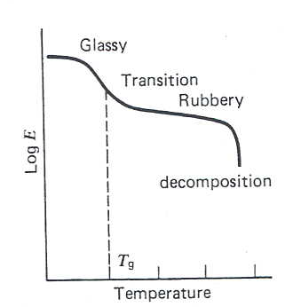
Effect of High Temperatures
Resins will soften due to excessive heat
The tensile, compressive, and shear properties of the resin diminish when temperatures approach the Glass Transition Temperature, T_{g}
  T_{g} values are approximately 250ºF (120ºC) for vinylester resins which are typically used with GFRP rebars
  T_{g} lowers as a result of moisture absorption

Slide 18
FRP bars
Looks are deceiving

Slide 19
Pultrusion Process
Manufacturing Processes
Heated Die
Cured
Profile
Resin
Most products are manufactured with this process
Notes:
First, we need to understand a composites manufacturing process called pultrusion. Most products used for transportation infrastructure applications including rebar, structural profiles, girders, decks, and strengthening materials use pultrusion to manufacture the product.
The process starts as long continuous fibers called rovings (either glass or carbon fiber) are pulled through a resin bath to saturate the fibers, then the wet fibers are aligned and pulled through a shaped mold die which is heated. While the composites are in the die, the shape is formed and fully cured. The completed profile exits the die and is cut to length based on the requirements for the order.

Slide 20
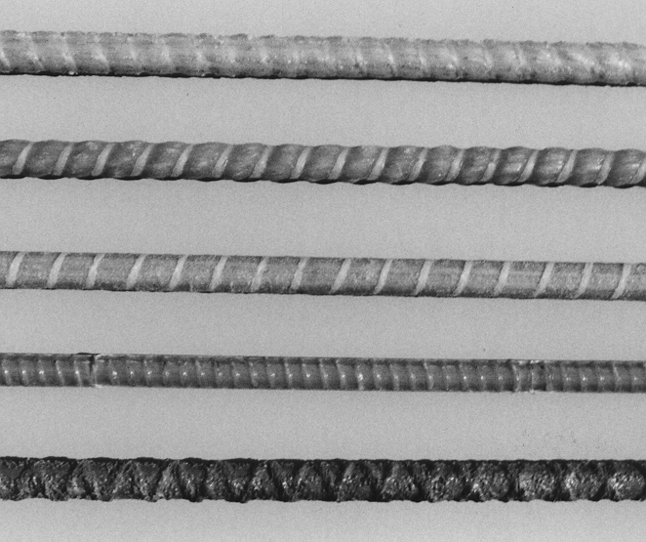
FRP Bar Types
Materials
  Glass/ vinylester
  Carbon/ vinylester
Forms
  Solid

Slide 21
FRP bar types
Surface
  Ribbed (a)
  Sand Coated (b)
  Wrapped and Sand Coated (c)
  Deformed
  Helical

Slide 22
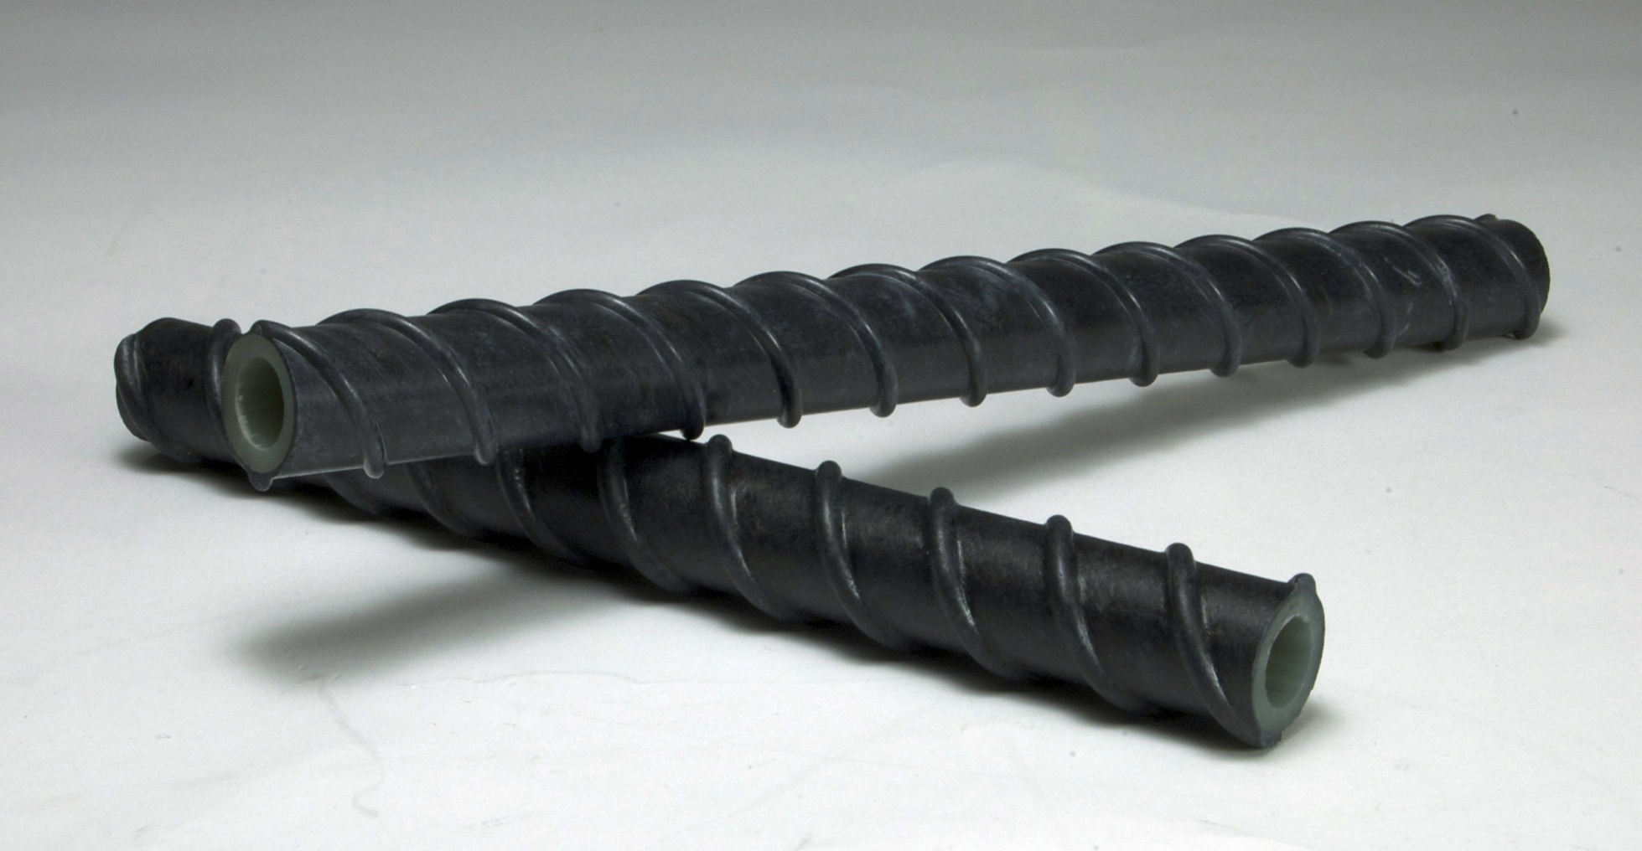
Innovation – hollow bar - coming soon
Courtesy of Composite Rebar Technologies, Inc.

Slide 23
Bar Sizes
^{Bar Size} |  |  | ^{Nominal Diameter}
^{Imperial} | ^{Metric} |  | ^{Imperial} | ^{Metric}
^{Inches} | ^{mm} |  | ^{inches} | ^{mm}
^{#2} | ⁶ |  | ^{0.25} | ^{6.35}
^{#3} | ¹⁰ |  | ^{0.375} | ^{9.53}
^{#4} | ¹³ |  | ^{0.4} | ^{12.7}
^{#5} | ¹⁶ |  | ^{0.625} | ^{15.88}
^{#6} | ¹⁹ |  | ^{0.75} | ^{19.05}
^{#7} | ²² |  | ^{0.875} | ^{22.23}
^{#8} | ²⁵ |  | ¹ | ^{25.4}
^{#9} | ²⁹ |  | ^{1.125} | ^{28.65}
^{#10} | ³² |  | ^{1.25} | ^{31.75}

Slide 24
Strength and Modulus Grades
Strength grade is based on ultimate tensile strength of the bar.
Lowest grade is 60 ksi
Strength is provided on 10 ksi increments
Modulus grade corresponds to minimum modulus of the selected bar.
Grade F 60
→
>60 KSI
Grade F 300
→
>300 KSI

Slide 25
Standards & Specifications
Translating research into industry standards

Slide 26
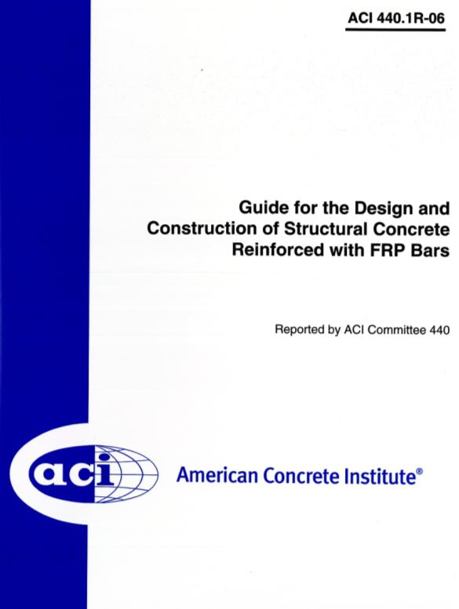
ACI – rebar design guideline
Design principles well established through extensive research
Guideline documents published in North America, Europe, Japan
Non-mandatory language
Notes:
First published in 1999, the ACI 440.1R-06 evolved from emerging technology to ACI standard publications on the use of FRP bars to reinforce concrete. This publication has gone through 3 iterations over the years to refine the design equations used in this document. This has become a well reference and used world-wide design document as the authority for internally reinforced concrete with FRP bars.

Slide 27
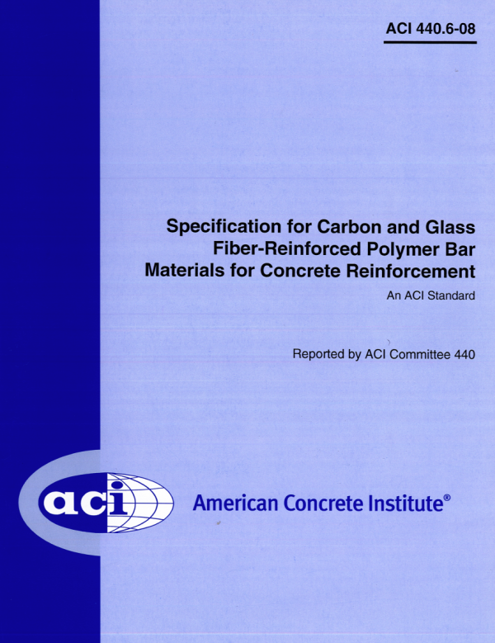
ACI – rebar, materials spec
ACI 440.6-08, mandatory language (standard document)
Provisions governing testing and evaluation for certification and QC/QA
Describes permitted constituent materials, limits on constituent volumes, and minimum performance requirements
Notes:
As a compliment to the ACI 440.1R design specification, this ACI standard was developed for contractors and specifiers who use either glass or carbon FRP bars as a materials specification to be used in contract documents. It is written in mandatory language and contains provisions governing testing, evaluation, and certification of FRP bars used in reinforced concrete.
Attention was placed on minimum requirements the FRP bars must meet to ensure durable performance.

Slide 28
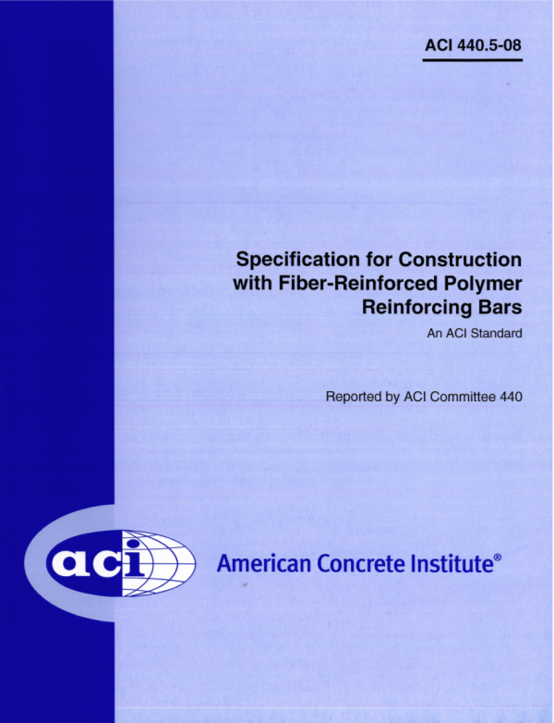
ACI – rebar, construction spec
ACI 440.5-08, mandatory language (standard document)
GFRP bar preparation, placement (including cover requirements, reinforcement supports), repair, and field cutting
Notes:
This ACI standard also serves as a compliment to the ACI 440.1R design specification. This construction standard provides information for contract documents that guide contractors and engineers on the proper use and installation of FRP bars for reinforced concrete.

Slide 29
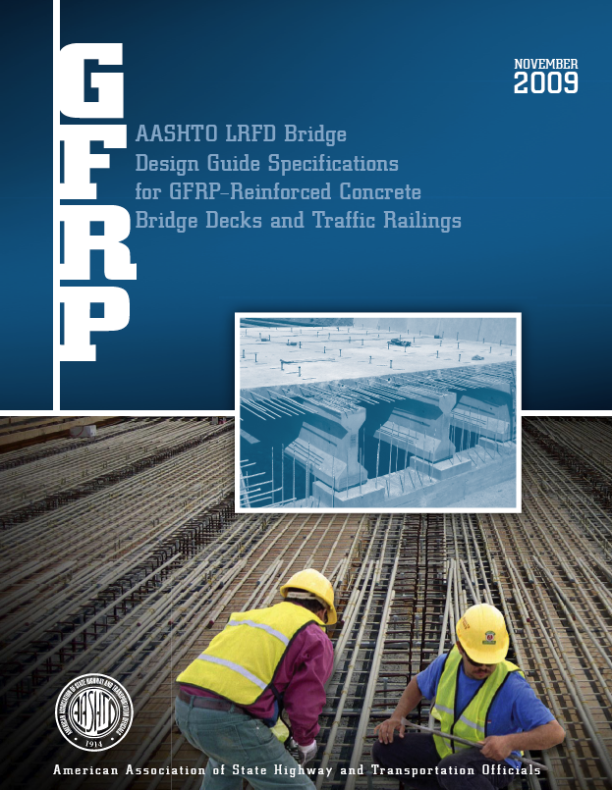
AASHTO design guide
New AASHTO LRFD design guide specifications published 11/2009
Bridge decks and traffic railings, glass FRP (GFRP) bars
Specific properties of GFRP reinforcement, design algorithms and resistance factors, detailing, material and construction specifications
Notes:
One noteworthy design standard published by AASHTO in 2009 is the AASHTO LRFD Bridge Design Guide Specifications for GFRP Reinforced Concrete Bridge Decks and Traffic Railings. Using the ACI design guide as a foundation, this publication will assist bridge engineers in specifying FRP rebar in concrete bridge decks.
This was the second of two AASHTO publications to cover FRP.

Slide 30
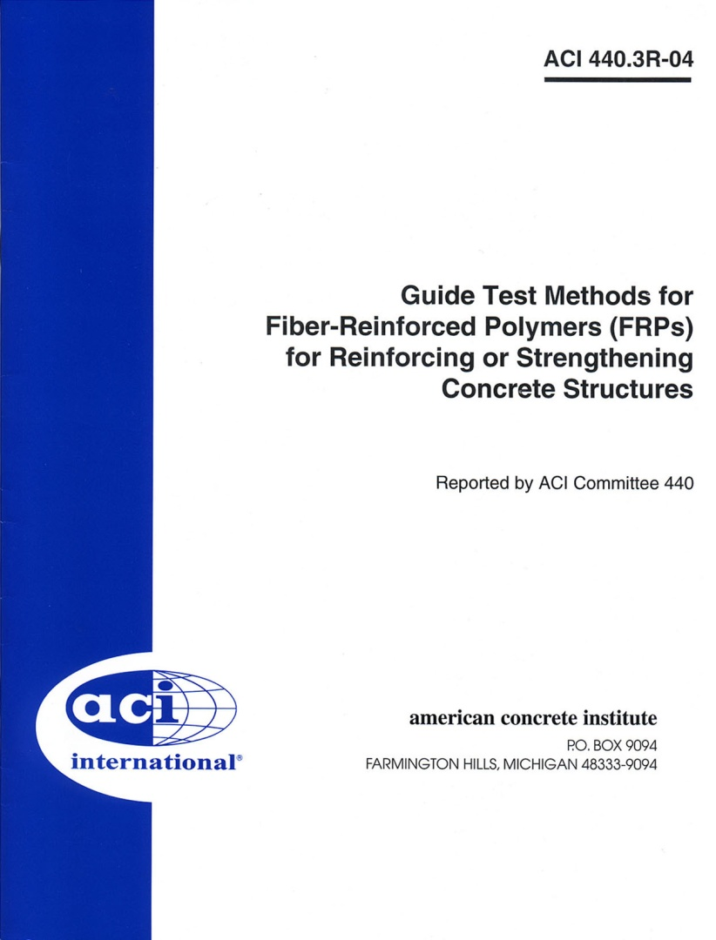
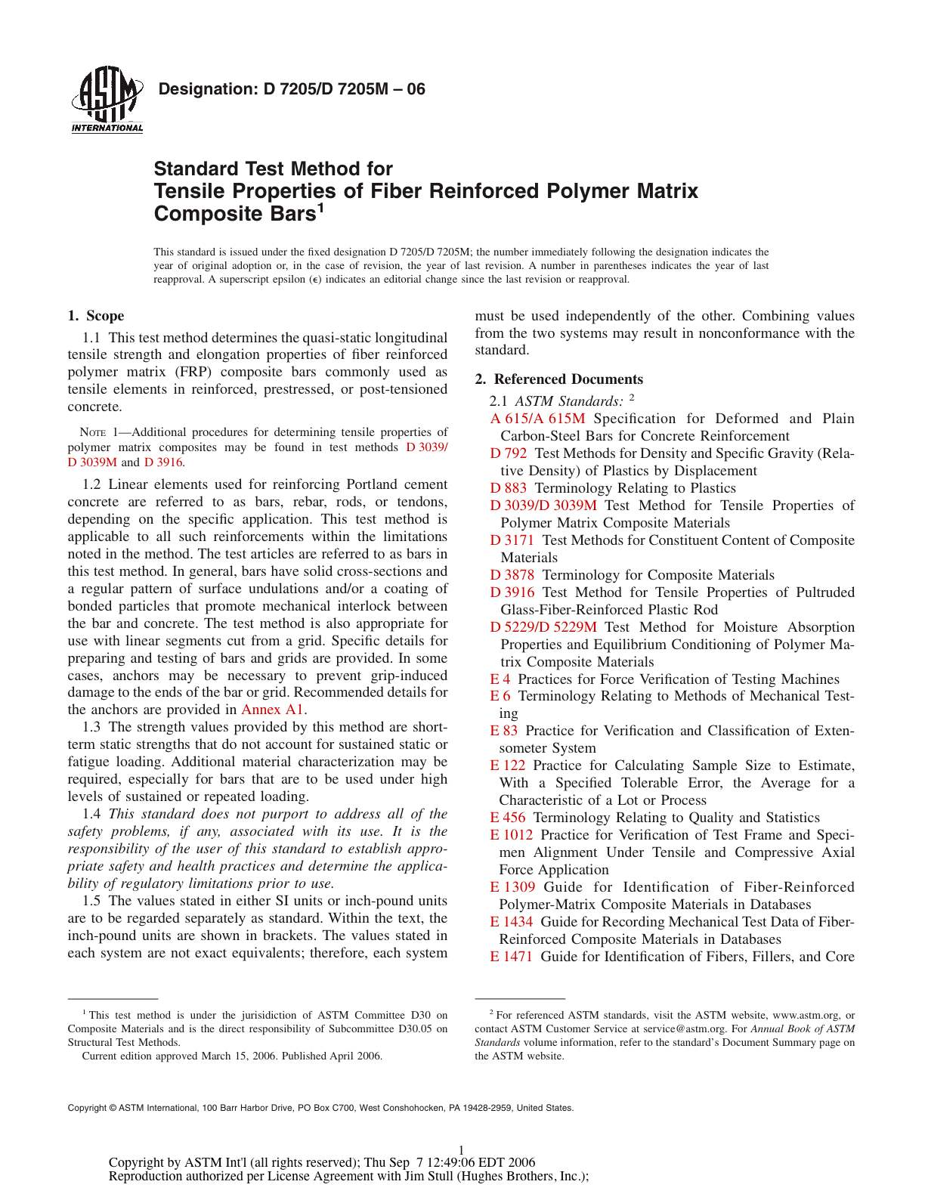
ACI Test methods

Slide 31
Rebar Test Methods
ACI 440.3R-04 – (12) test methods for FRP rebars
ASTM D30 (Composite Materials) and D30.05 (Structural Test Methods) committees, now D30.10
Test Method | ASTM Standard
B.1. Bar Cross-Section | D7205-06 (R11)
B.2. Bar Tension | D7205-06 (R11)
B.4. Bar Transverse Shear | D7617-11
B.6. Bar Alkaline Tension | WK27200
B.8. Bar Creep Rupture | D7337-07
App. A. Bar Anchors | D7205-06 (R11)

Slide 32

Canada - Highway Bridge Design Code
Technology transitioned from government-subsidized research projects to actual commercialization
Experience gained on viability of construction management practices where FRP reinforcement is adopted through traditional bid letting processes and competitive bidding from multiple FRP bar suppliers
Notes:
In Canada, FRP bars used in the design of concrete bridge decks have been codified in the Highway Bridge Design Code. The existence of this document has motivated all Canadian provinces to specify and install FRP rebar as a material of choice for concrete exposed to aggressive environments.

Slide 33
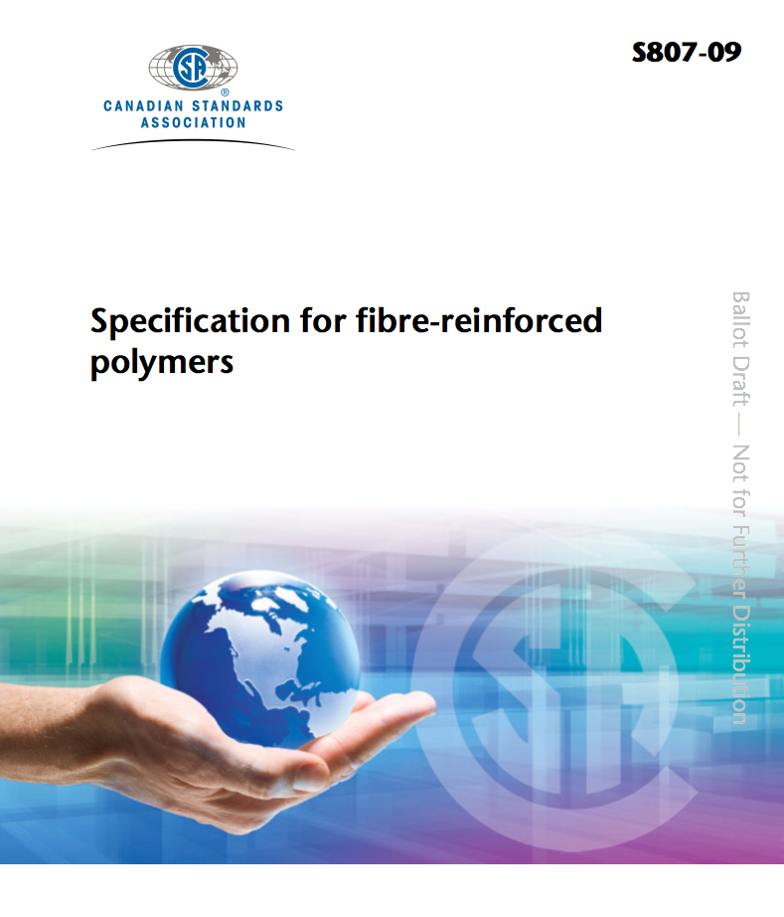
Canadian Standards
CSA S807 – 09
Qualification and QA criteria

Slide 34
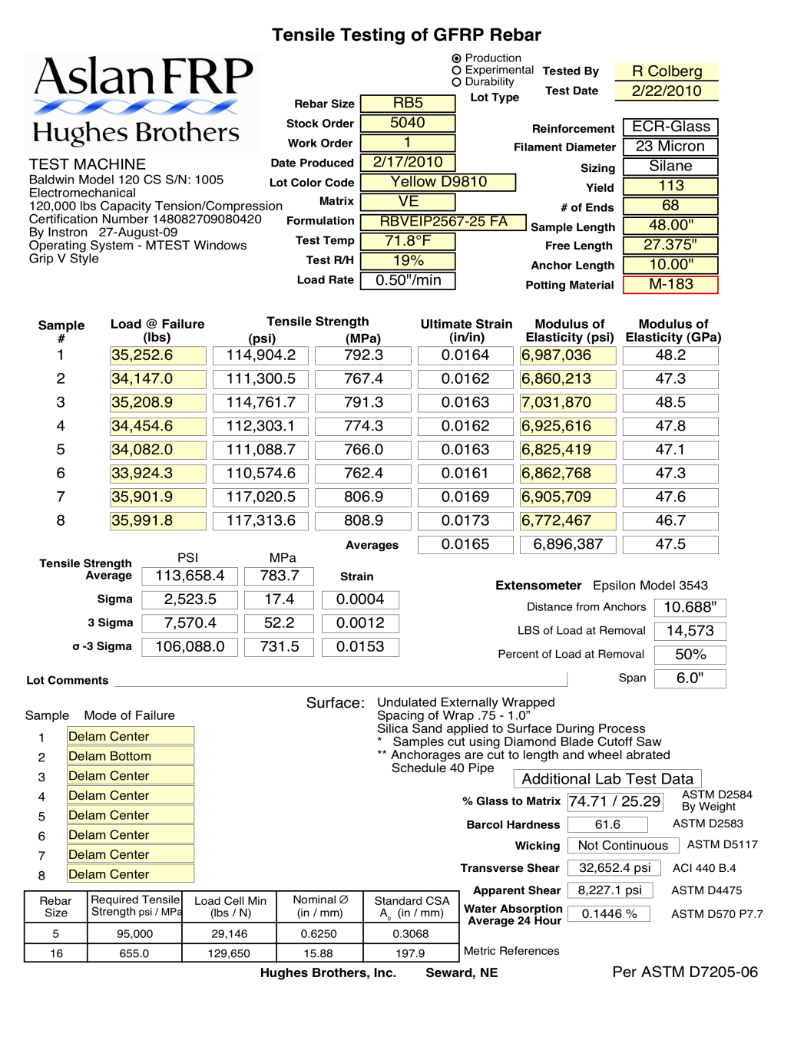
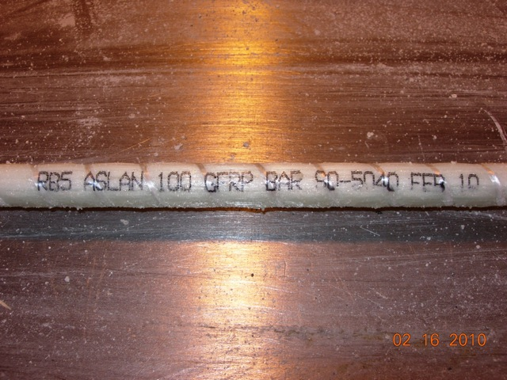
Quality Assurance - Verification and traceability of bar properties

Slide 35
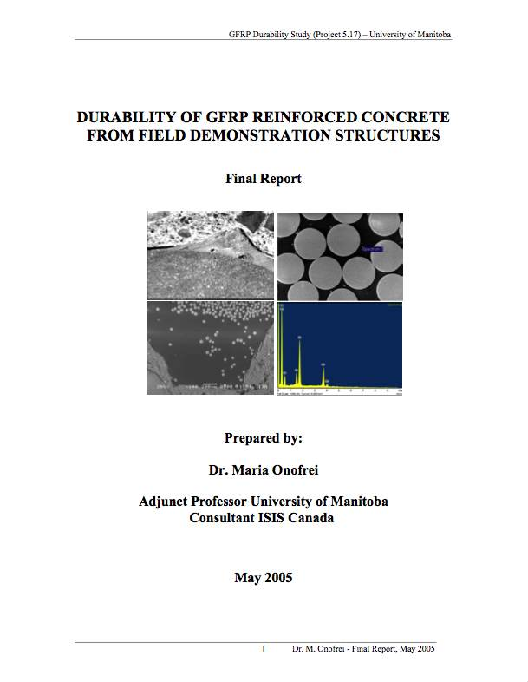
Durability
ISIS Canada reports on Durability performance of GFRP bars in Bridge Decks in Service for 8-10 years
Multiple reports from several institutions

Slide 36
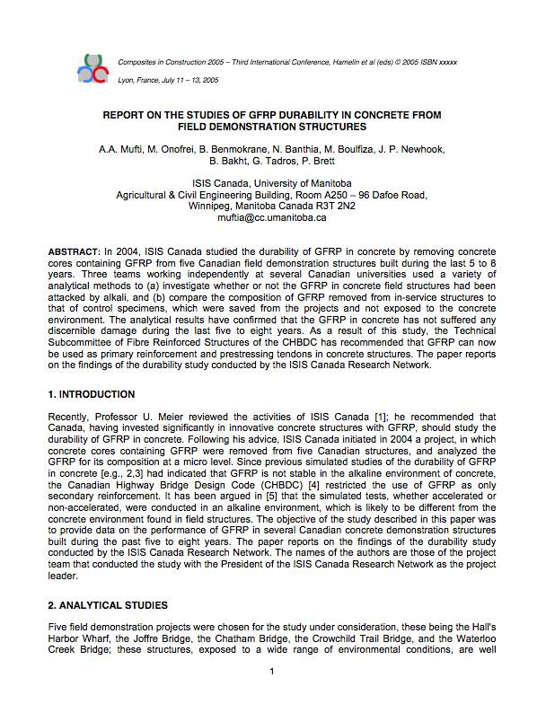
NO Degradation of GFRP bars found !

Slide 37


…..a closer look

Slide 38
Applications
Many installations and growing

Slide 39
TEA-21
FY 98-03 - IBRC Program
124 FRP Projects - $87M funded
  44 decks
  14 rebar
  33 repair
  6 tendons
  27 others (i.e. FRP glulam)
19 states with FRP decks
Future funding - uncertain

Slide 40
Installations Today
In the U.S.
  >190 installations that use FRP composites
  >50 installations where FRP bars are used in bridge decks
  15 states (CO, FL, IA, IN, KY, MO, NC, NY, OH, OR, TX, UT, VT, WI, WV) use FRP bars in bridge decks
In Canada,
  >195 installations that use FRP composites
  190 installations use FRP bars in bridge decks, parapets, barriers, sidewalks

Slide 41
Applications
Cast in Place
Precast
Top mat
Top and bottom mat
Decks, parapets, sidewalks
Other applications: tunneling (soft eye, seawalls, MRI rooms, light rail foundations, railway girders, culverts, and many more.

Slide 42
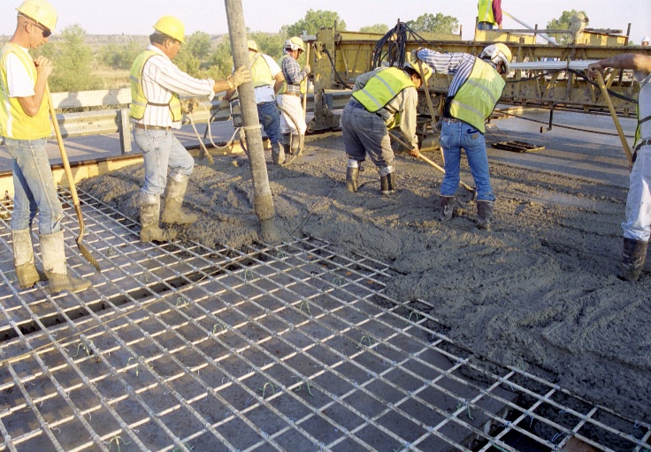
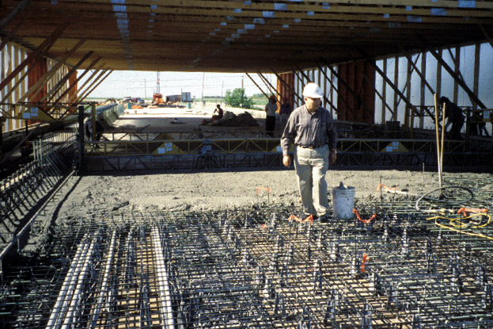
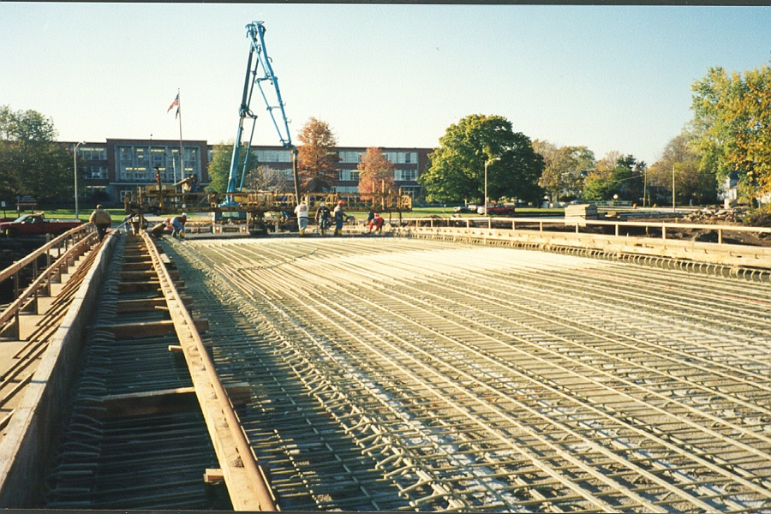
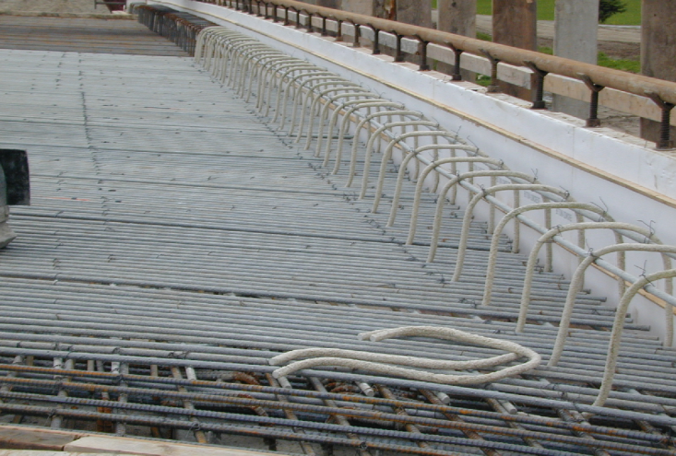
FRP Rebar for Decks &
Approach Slabs
Applications
Sierrita de la Cruz Creek Bridge
USA
Pierce Street Bridge, Lima OH
USA
Wotton, Quebec
Canada
Taylor Bridge
Manitoba
Canada
Notes:
Since the early 1990’s, FRP rebars have been used in a variety of bridge deck applications. There are in excess of over 200 installations in North America that use FRP rebar today. Several of those installations are shown in these pictures. In every case, FRP rebar is either used in the top mat, or top/bottom mat of the deck. FRP rebars corrosion resistance provides engineers with alternative materials for structures in aggressive environments.

Slide 43
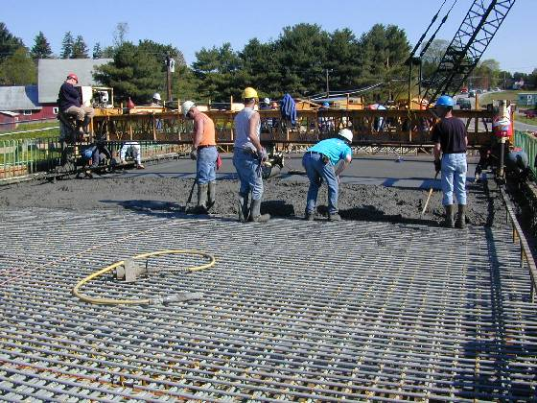
Morristown Bridge Vermont 2002
Concrete cast-in-place
May 2002
Bridge opened to traffic
July 2002
Courtesy of Pultrall, Inc.

Slide 44
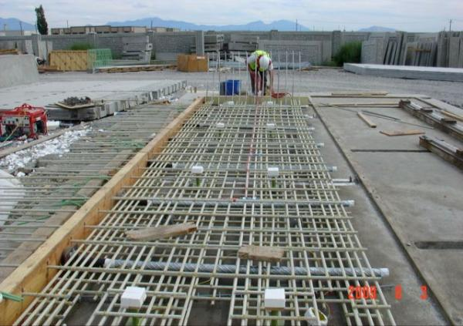
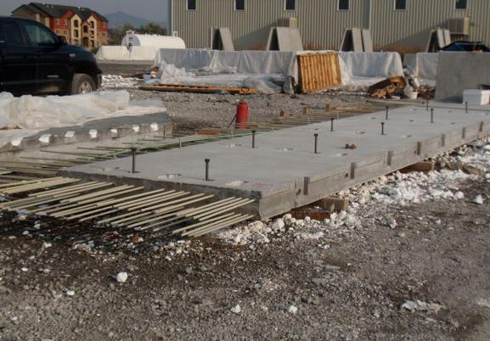
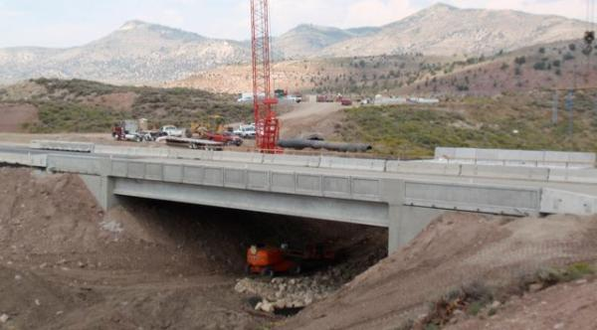
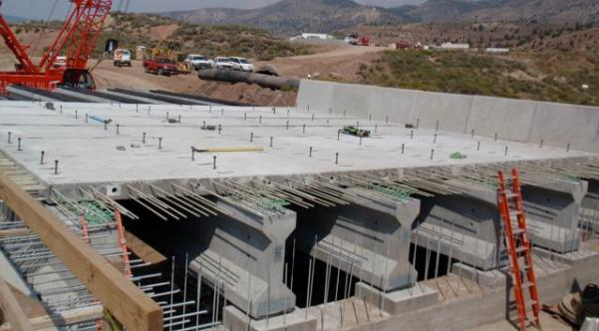
Emma Park Bridge, Pleasant Grove, Utah DOT, 2009
3. Impact
(Courtesy of Hughes Brothers, Inc.)

Slide 45
Emma Park Bridge
Full Depth Precast – top & bottom mat
Cost premium in 2009 to use GFRP over Epoxy bar
    14% greater deck cost – due in large part to additional girders
    On a 1:1 basis, GFRP bars equal in unit price to epoxy steel
Polymer overlay adds 3% to cost of bridge – not needed with GFRP bar
  Additional 6 years of service life makes up for premium
  Typical service life today is 25 to 30 years for decks

Slide 46
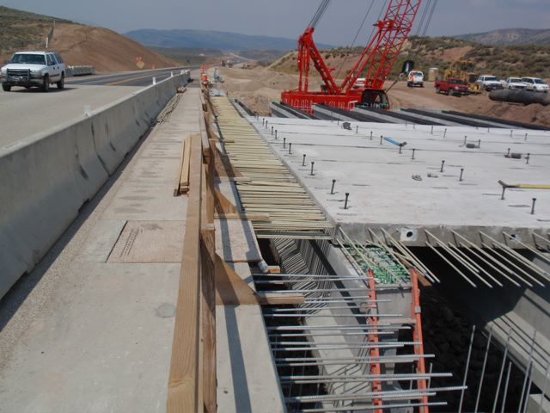
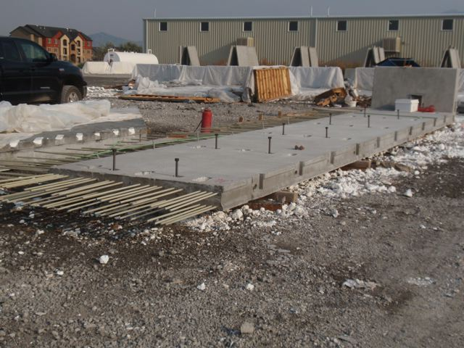
Emma Park Bridge
Courtesy of Hughes Brothers, Inc.

Slide 47
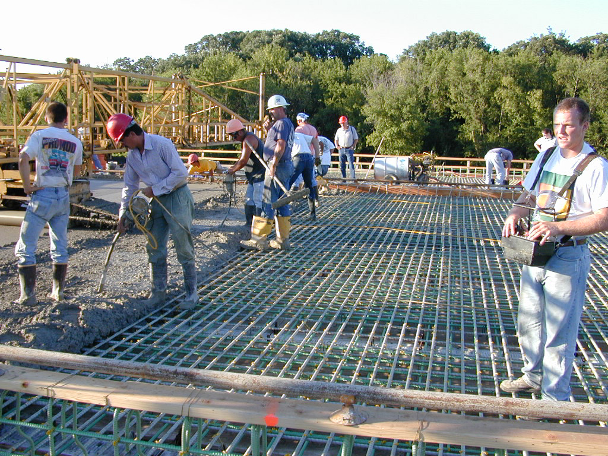
53rd Ave Bridge Bettendorf, IA 2001
Courtesy of Hughes Bros.

Slide 48
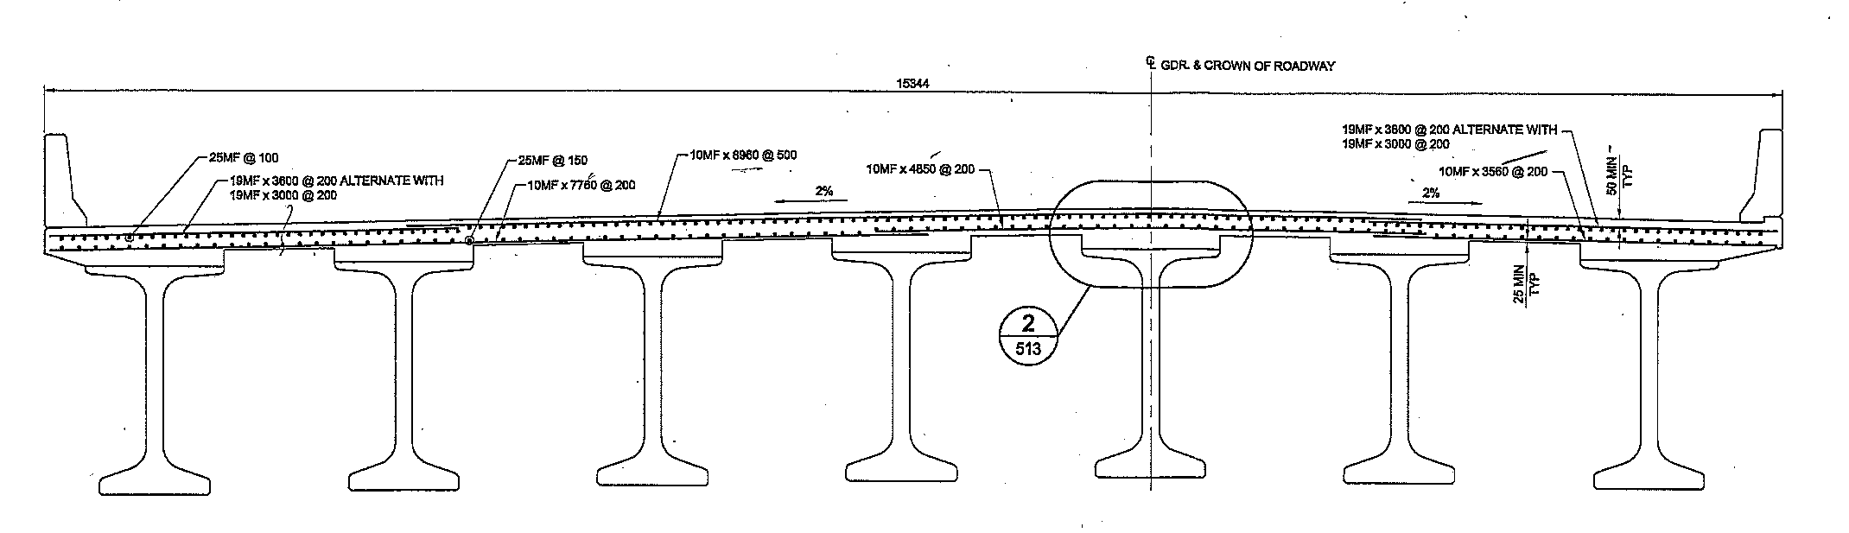
Floodway Bridge, Manitoba, Canada
2 Bridges 8 spans each
2 Lanes Each Bridge
142 feet typical span
1136 feet total length (1/5 mile)
50 foot Wide
9 inch thick Deck Slab
8 feet Girder Spacing

Slide 49
Floodway Bridge, Manitoba, Canada
Largest Steel Free Deck Project
Largest FRP reinforced bridge in the world
8 Truckloads of GFRP Rebar
150 Tons of GFRP = 1.2 million lbs of steel rebar (30 truckloads)
  Primarily #8 and #3 Longitudinal
  #6 Transverse
3200 CY concrete (6400 tons)

Slide 50
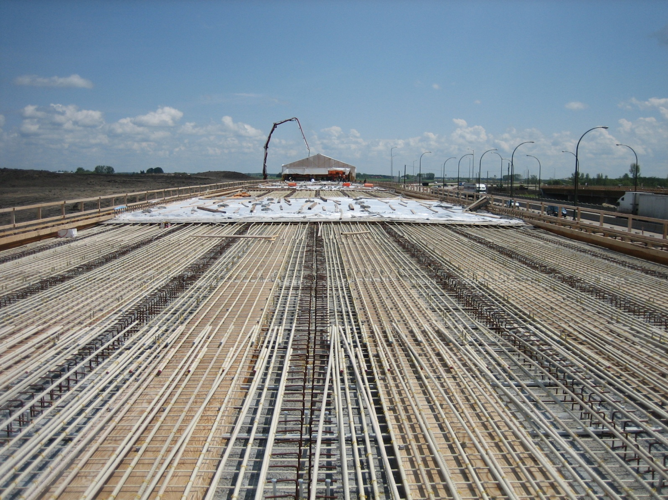
Floodway Bridge, Manitoba, Canada
Courtesy of Hughes Bros.

Slide 51
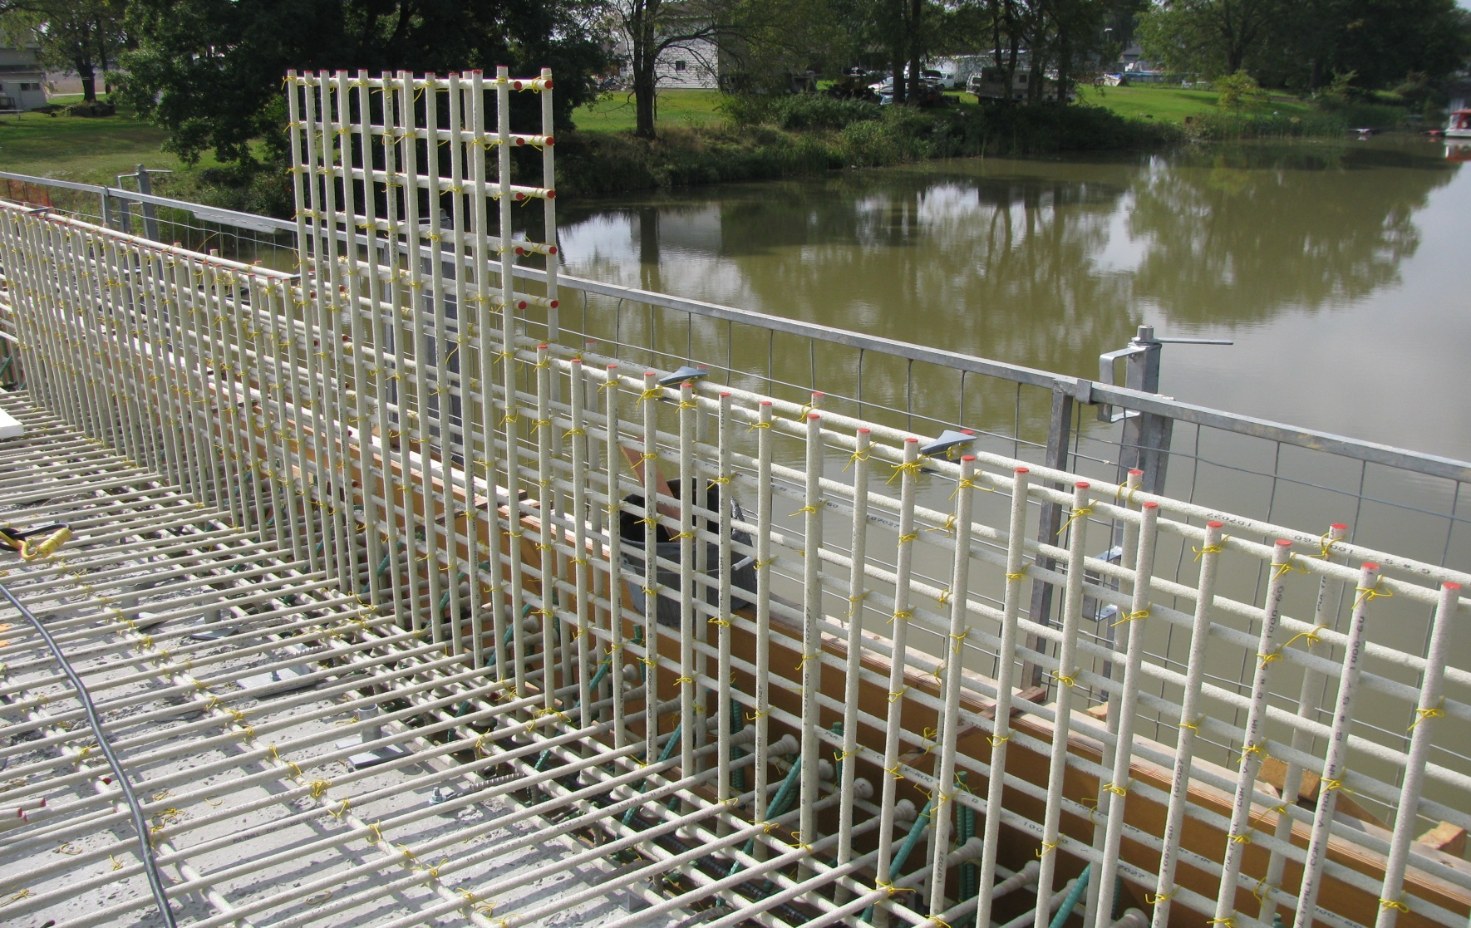
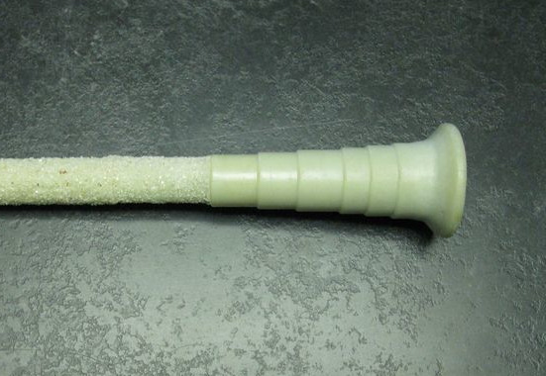
O’Reilly Bridge - Canada
New anchor head used
Courtesy of Pultrall, Inc.

Slide 52
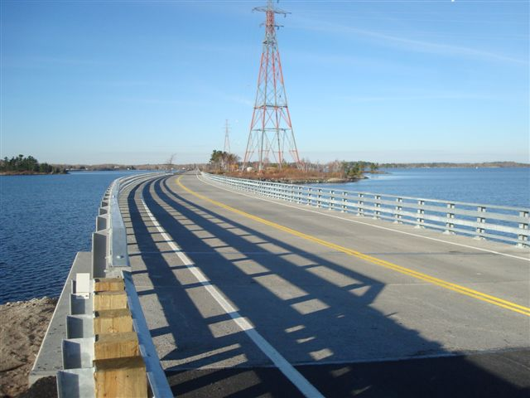
Noden Causeway
Prestressed/precast deck
Courtesy of Pultrall, Inc.

Slide 53
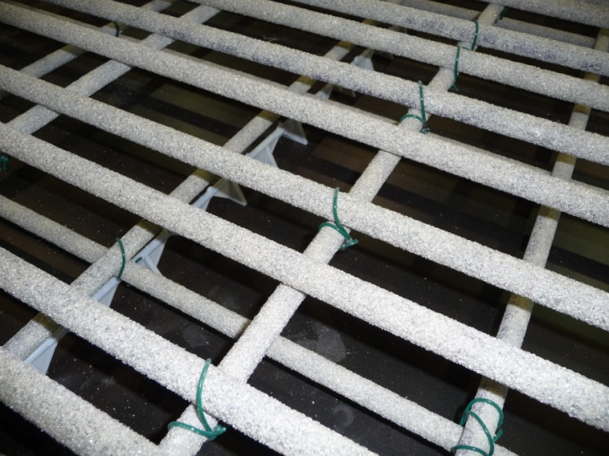
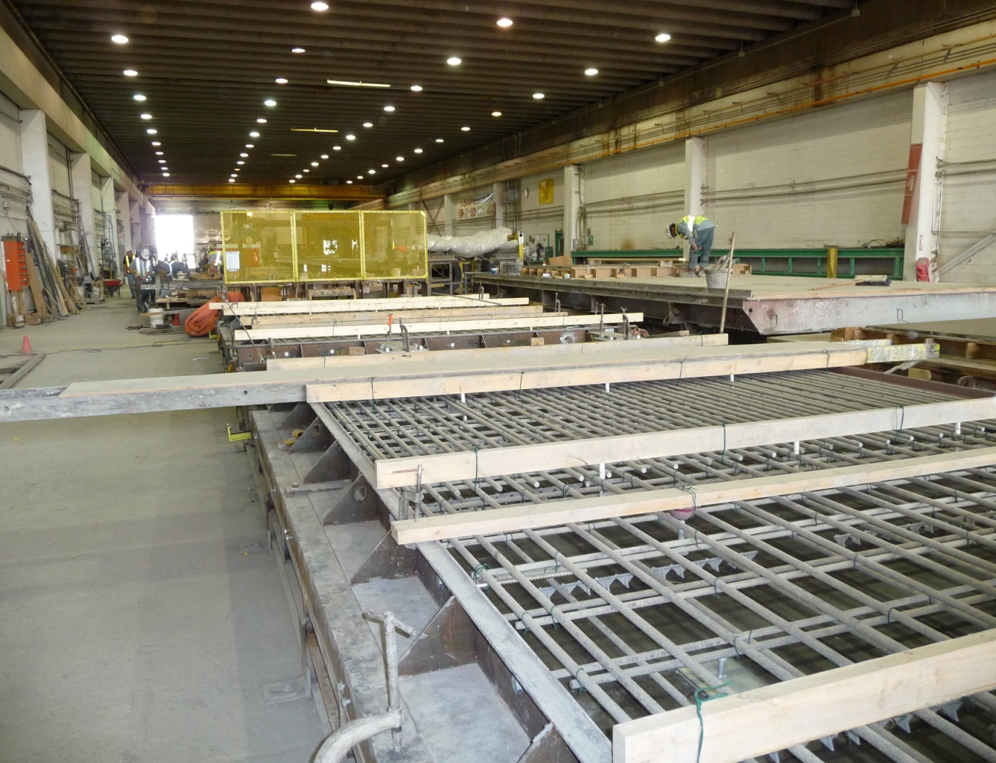
Noden Causeway
Courtesy of Pultrall, Inc.

Slide 54
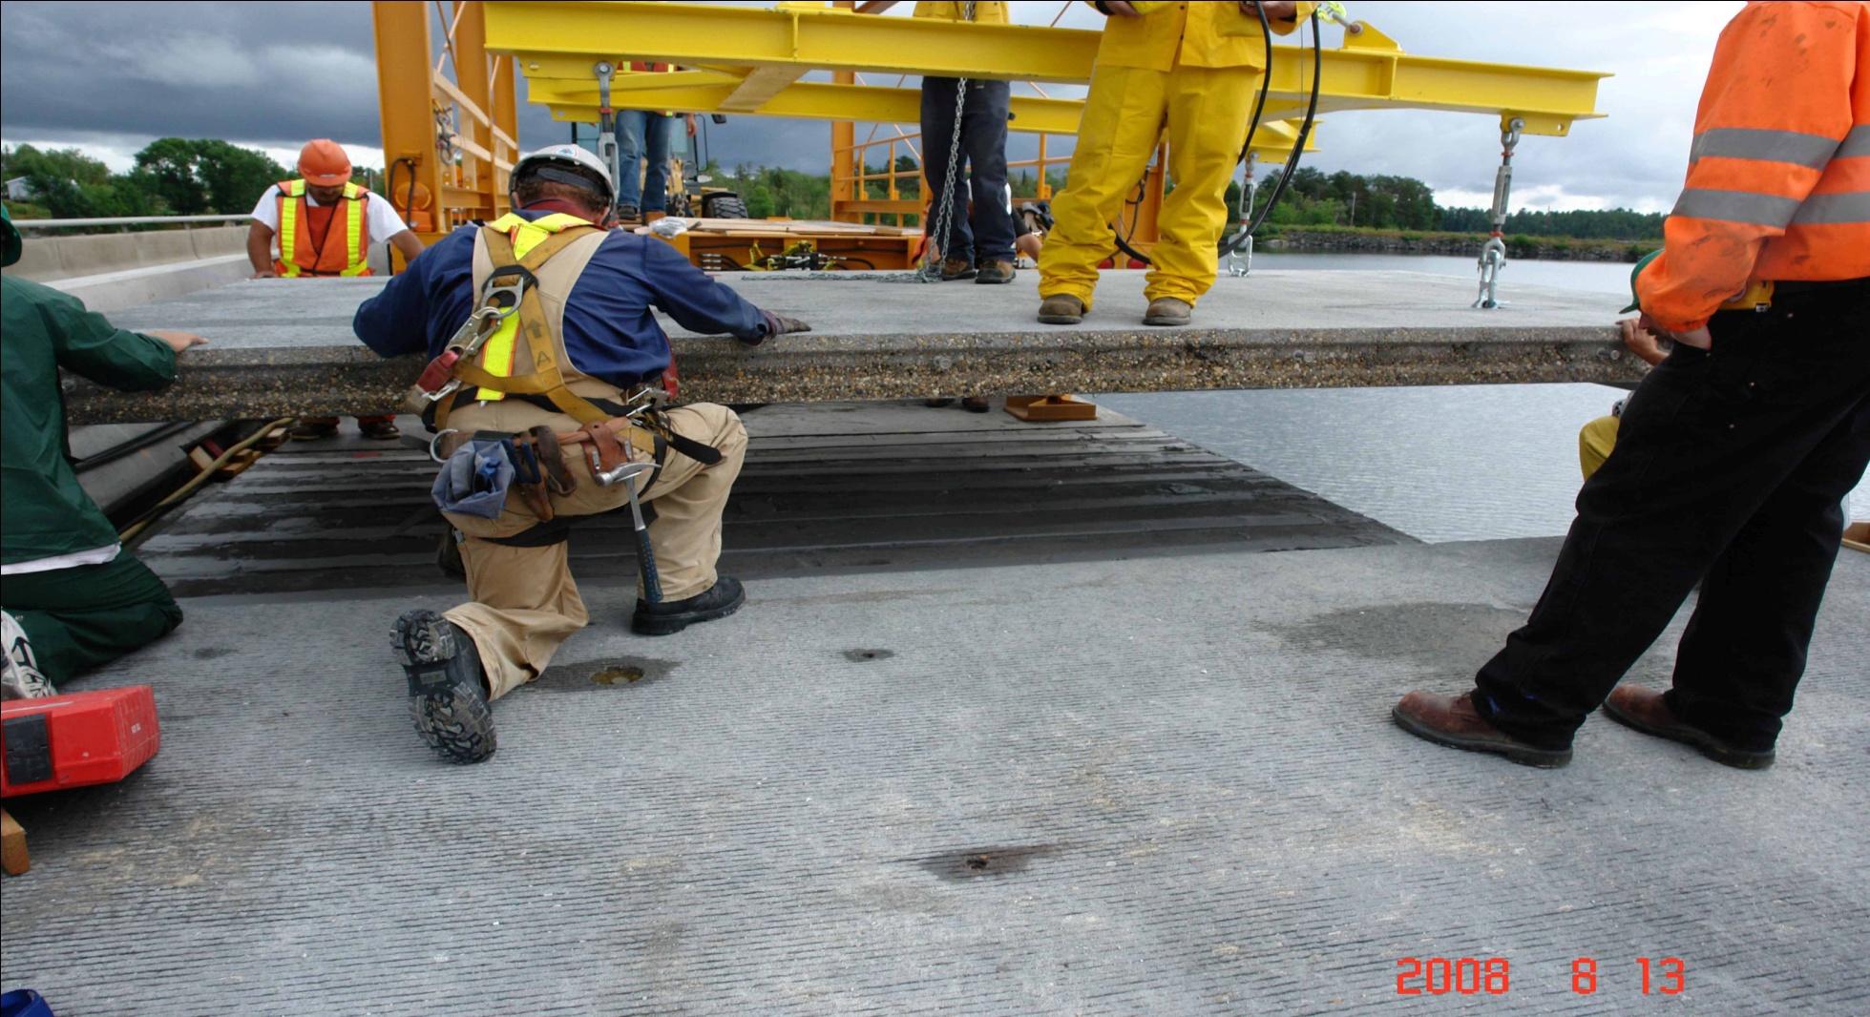
Noden Causeway
Courtesy of Pultrall, Inc.

Slide 55
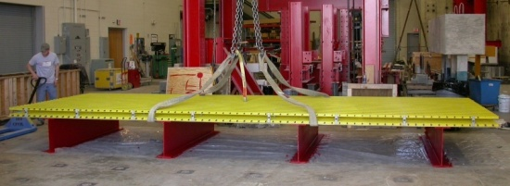
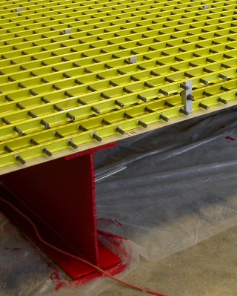
Prefabricated FRP stay-in-place reinforcement panels
Large-size 24’ x 8’, double-layer stay-in-place (SIP) reinforcing panels pre-assembled using off-the-shelf pultruded GFRP components
Notes:
A technology developed over 8 years ago introduced another approach to reinforced concrete decks that incorporate a structural stay-in-place formwork coupled with a 3 dimensional grid reinforcement. The reinforcement is made from existing pultruded grating bars that are joined together to form a grid. These grids can be formed into panels, much like prefabricated FRP decks, and installed on a bridge.
Prefabricated stay-in-place FRP reinforcing panels take advantage of advanced composites’ versatility, light weight, and corrosion resistance, to make the construction of durable bridge decks faster, safer, and competitive.

Slide 56
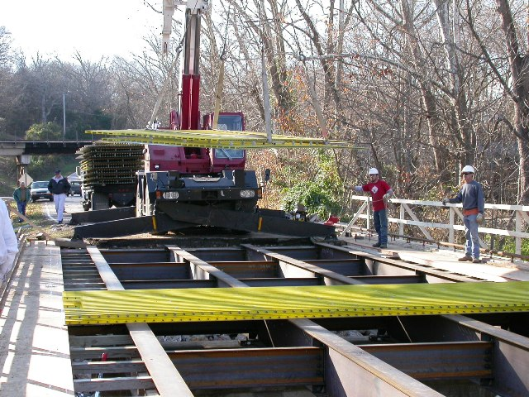
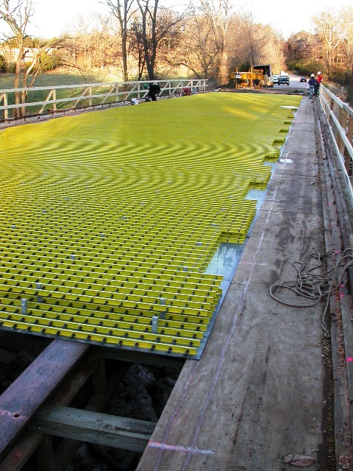
Deck construction
Day 1: SIP panels setting and anchoring
Notes:
The construction process was performed in a simple 5-day sequence of events. Day 1 was assigned to setting the panels in place. Note that a light duty truck crane was used to place the panels.

Slide 57
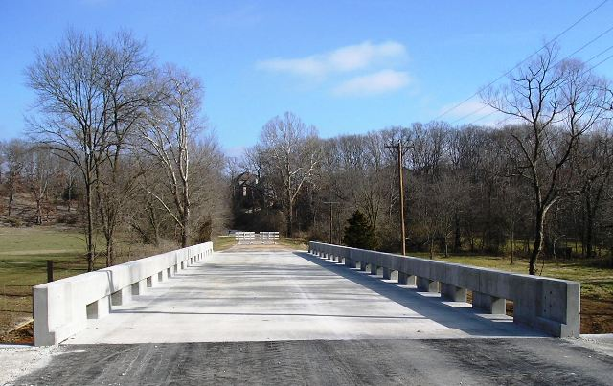
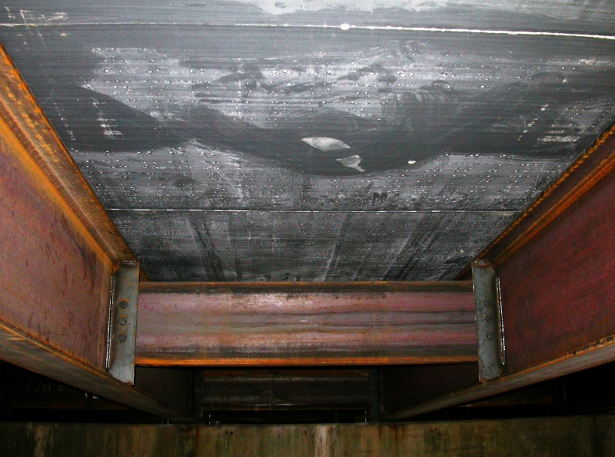
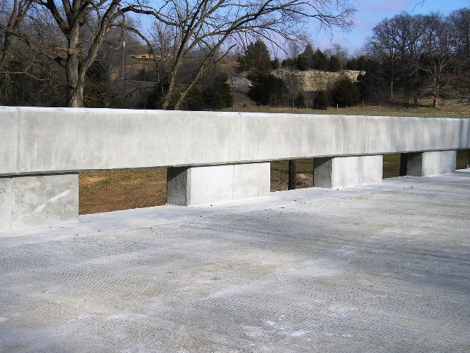
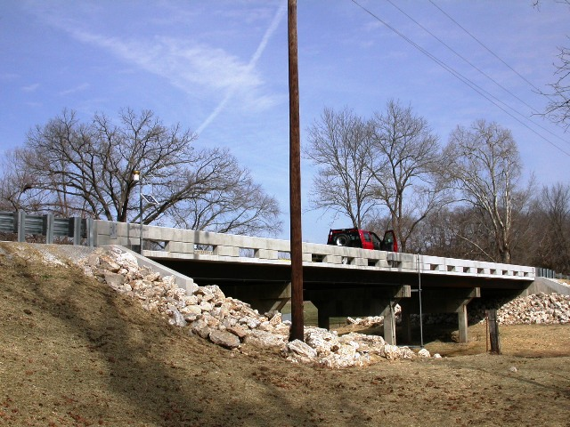
Notes:
This composite picture shows various views of the completed structure.
Easier and faster construction – the elimination of labor-intensive and time-consuming field operations (formwork setting between the girders, and tying of rebars) by means of large-size prefabricated FRPpanels lifted with a single pick of a crane, translates into over 70
percent reduction in construction time from reinforcement installation to deck casting and finishing, as well as into significantly improved working conditions.
Higher Productivity – the rate of concrete placement is increased by 50 percent compared to traditional steel reinforced decks with similar dimensions.
Reduced Labor Cost – the reduced need of manpower, faster and easier field operations, and higher productivity translate into over 75 percent reduction in deck construction labor cost.
Improved safety – the use of very lightweight FRP panels, easy to handle and placed with no need of formwork (as opposed to heavy partial-depth precast prestressed panels commonly used), and the design of the reinforcing profiles to facilitate walking over the top mat, result in improved safety in the work area.
Enhanced durability – to date, the results of extensive research have demonstrated the superior durability of internal FRP reinforcement for concrete when compared to steel rebars. The corrosion resistance of FRP composites represents a critical advantage for bridge decks, which are highly susceptible to deterioration due to chloride (deicing salts) penetration. This translates into a reduction in bridge maintenance operations, thereby supporting a more efficient bridge management, and prioritization of limited funds.

Slide 58
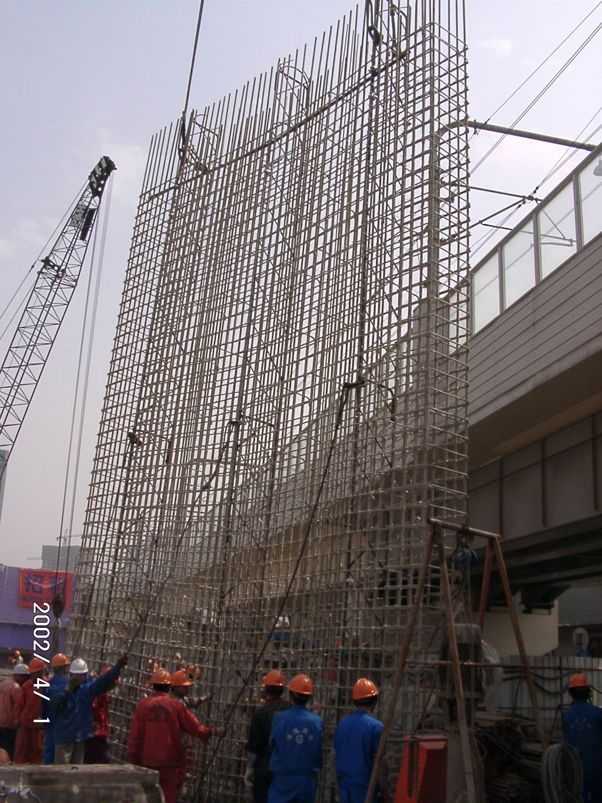
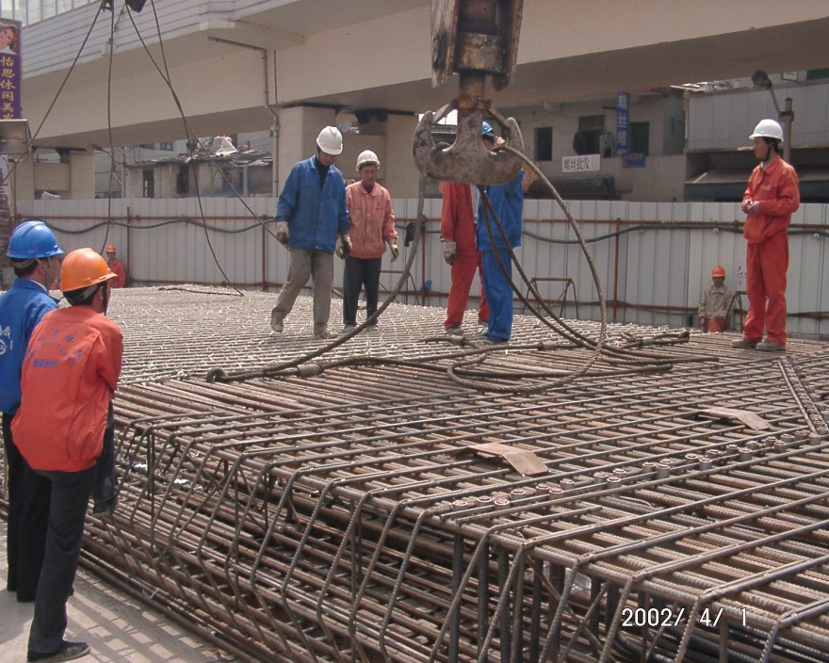
Tunneling, soft-eye
Yi Shan Station Shanghai
Courtesy of Hughes Brothers, Inc.

Slide 59
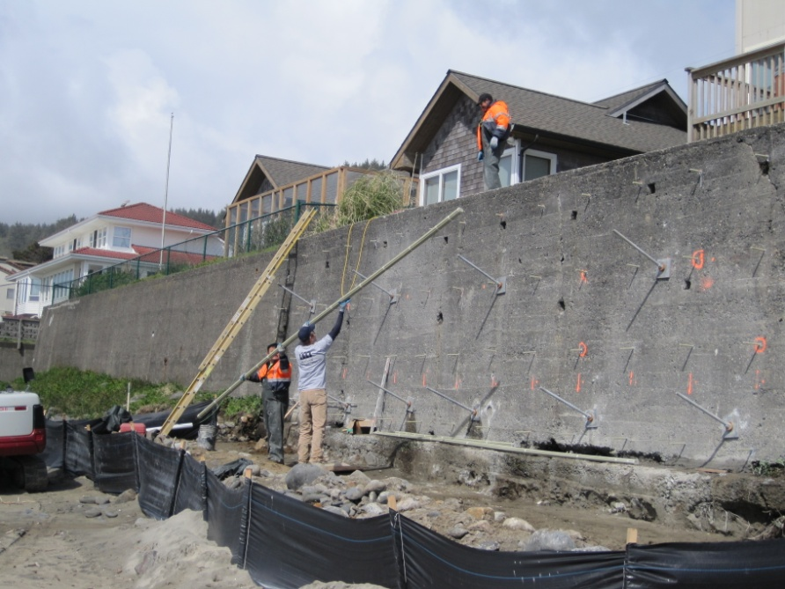
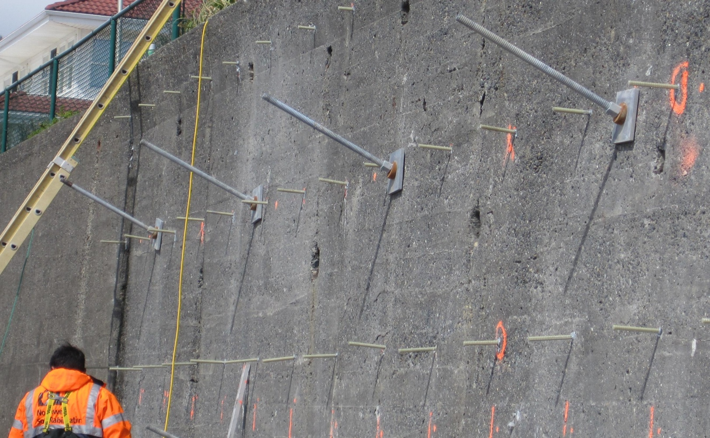
Seawalls
Courtesy of Marshall Composite Tehnologies

Slide 60
Summary
Complete set of guides, test methods and standards are available for GFRP bars
Many bridges built with GFRP bars and performing well
Non-proprietary solution, traditional supply chain acquisition & installation in place
Extended service life of GFRP reinforced decks is expected
Many practices adopted for corrosion protection are not necessary with FRP bars
Holistic view of bridge deck construction makes FRP bars the best value proposition
Notes:
In summary FRP composites are:
Engineered systems
Prefabricated components, factory built, quality controlled
Reduces the need for large, heavy, expensive equipment during installation
Increases safety on site
Lighter Weight for Reduced Shipping, Handling and Erection Time and Costs (Accelerated Bridge Construction)
Reduced Carbon Footprint
Greater Corrosion Resistance than Conventional Materials Providing Service Lives Beyond 100 Years
LOWER OVERALL BRIDGE COST!!

Slide 61
Composites Conference
www.acmashow.org
COMPOSITES 2013
Orange County Convention Center, Orlando, FL
January 29-31, 2013
Over 4,000 attendees
Sessions on infrastructure and construction
Expo with suppliers and manufacturers

Slide 62
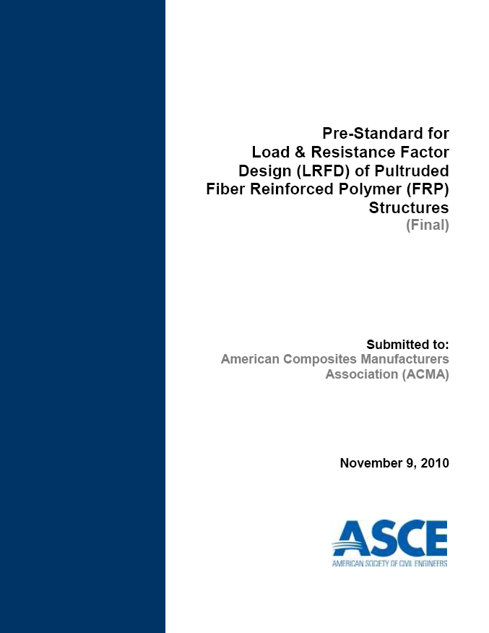
LRFD – Pultruded Composites
Pre-Standard released 2010
    Ch. 1 General Provisions
    Ch. 2 Design Requirements
    Ch. 3 Tension Members
    Ch. 4 Compression Members
    Ch. 5 Flexural and Shear Members
    Ch. 6 Combined Forces & Torsion
    Ch. 7 Plates and Built-Up Members
    Ch. 8 Bolted Connections
Notes:
ASCE, under contract with the American Composites Manufacturers Association completed a 3-year project to develop a new design pre-standard titled LRFD of Pultruded Fiber Reinforced Polymer (FRP) Structures. This pre-standard was published in late 2010 and is currently going through the ASCE standards process to promulgate this document as a standard.
The publication covers a number of areas of pultruded composites including tension members, compression members, flexural and shear members, combined forces and torsion, plates and built up members, and bolted connections. Each of the chapters follows the LRFD design provisions laid out in chapters 1 and 2.
The LRFD document can be applied to all pultruded structural elements.

Slide 63
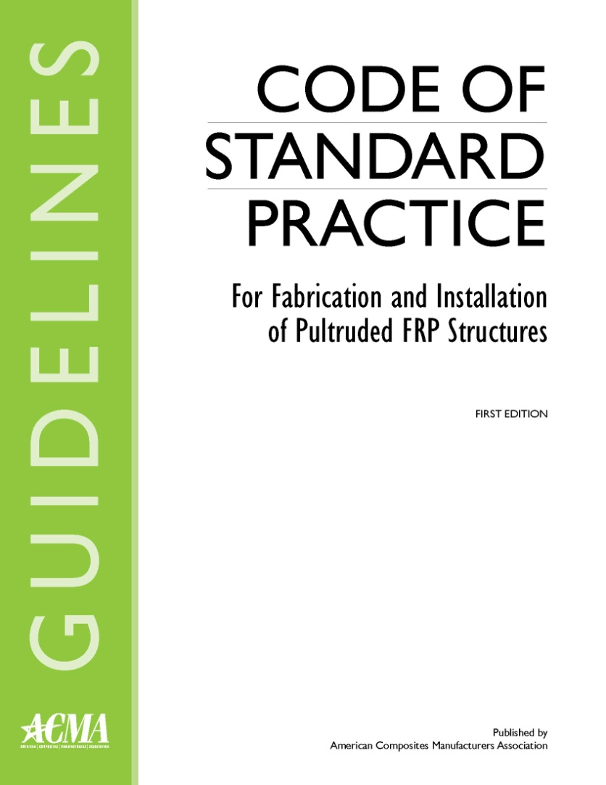
Code of Standard Practice
Industry Guidelines
Released December 2011
Balloting for ANSI standard in progress
ANSI Standard approved in March 2012
  Publish, June 2012

Slide 64
Thank You
John P. Busel
Director, Composites Growth Initiative
American Composites Manufacturers Association (ACMA)
P: 914-961-8007
E: jbusel@acmanet.org

